Slide 1



Koneksi PHP ke MySQL
Jumadi, Ph.D.
+ www.ums.ac.id Humanizing * Liberating * Transcending

Slide 2
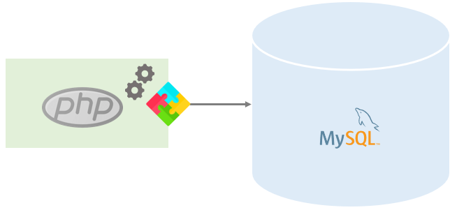
Teknik Koneksi PHP ke MySQL
mysqli Extension
PHP MySQL PDO Extension
Legacy mysql_ Functions (Deprecated)
+ www.ums.ac.id Humanizing * Liberating * Transcending

Slide 3
Koneksi dengan MySQLi
<?php
$hostname = "localhost"; // Masukan nama host
$username = "root"; // Masukan user database
$password = ""; //Masukan Password
$databasename = "latihan";// Masukan nama database
// Membuat koneksi
$connection = mysqli_connect($hostname, $username, $password,$databasename); // Cek koneksi if (!$connection)
{
die("Unable to Connect database: " . mysqli_connect_error());
}
// Jalankan Query, dll //.........
$mysqli -> close();
?>
+ www.ums.ac.id Humanizing * Liberating * Transcending

Slide 4
Menjalankan Query di PHP
// Jalankan Query, dll
$sql= "select * from mahasiswa“
//masukan perintah SQL
$mahasiswa = $connection -> query($sql)
//Menampilkan jumlah baris hasil query
echo "Jumlah baris dalam data: " . $mahasiswa -> num_rows;
+ www.ums.ac.id Humanizing * Liberating * Transcending

Slide 5
Menampilkan Data ke Browser
<body>
<table width="30%">
<tr>
<td width="20%">No</td>
<td width="50%">Nama</td>
<td width="30%">Jenis Kelamin</td>
</tr>
<?php
foreach($mahasiswa as $mhsbaris)
{
echo "<tr>";
foreach($mhsbaris as $mhs)
{ echo "<td>$mhs</td>"; }
echo "</tr>"; }
?>
</table>
</body>
+ www.ums.ac.id Humanizing * Liberating * Transcending

Slide 6

+ www.ums.ac.id Humanizing * Liberating * Transcending

